Slide 1
Blacktown Chinese Christian Church
Welcome to Our English Service 14.09.2025
English Service 9:45 – 11:00 am
Worship Songs: Passage: Speaker: Topic: Response Song: Announcements and Closing Prayer Benediction
Joy (What the world calls foolish) Cornerstone Still Goodness of God Matthew 27:45-55 Xavier Lakshmanan Jesus on the Cross TBA

Slide 2
BCCC english service

Slide 3

Please keep all phones on silent

Slide 4
Joy (What the world calls foolish)
CCLI Licence No: 5485849

Slide 5
Why would I not sing of Your praises?
Even when troubles come
Why would I not worship forever
'Cause I've seen the good You've done

Slide 6
And I'm not ashamed, I'm a sinner saved
No, I'm not afraid anymore
What the world calls foolish, You call freedom
No, I won't hold back anymore

Slide 7
I've got joy in the morning
Joy in the evening
You keep me dancing
In every season

Slide 8
Whatever comes tomorrow
I've got joy

Slide 9
I'm letting go, I'm wild in Your presence,
Dance till the sun comes up
You make me strong whenever I praise You
Jesus, You fill my cup

Slide 10
And I'm not ashamed, I'm a sinner saved
No, I'm not afraid anymore
What the world calls foolish, You call freedom
No, I won't hold back anymore

Slide 11
I've got joy in the morning
Joy in the evening
You keep me dancing
In every season

Slide 12
Whatever comes tomorrow
I've got joy

Slide 13
I've got joy in the sunshine
Joy in the rain
You keep me dancing again and again
Whatever comes tomorrow

Slide 14
I've got joy

Slide 15
I got joy, joy, joy down in my heart
I got joy, joy, joy down in my heart
I got joy, joy, joy down in my heart
Hallelujah (x2)

Slide 16
Cornerstone
Edward Mote, Eric Liljero, Jonas Myrin, Reuben Morgan, William Batchelder Bradbury © 2011 Hillsong MP Songs (Admin. by Hillsong Music Publishing Australia) Hillsong Music Publishing UK (Admin. by Hillsong Music Publishing Australia) Hillsong Music Publishing Australia CCLI Licence No. 5485849 . CCLI Song number: 6158927

Slide 17
My hope is built on nothing less
Than Jesus blood and righteousness
I dare not trust the sweetest frame
But wholly trust in Jesus name (x2)

Slide 18
Christ alone, Cornerstone
Weak made strong in the Saviour's love
Through the storm, He is Lord
Lord of all

Slide 19
When darkness seems to hide His face
I rest on His unchanging grace

Slide 20
In every high and stormy gale
My anchor holds within the veil
My anchor holds within the veil

Slide 21
Christ alone, Cornerstone
Weak made strong in the Saviour's love
Through the storm, He is Lord
Lord of all

Slide 22
He is Lord, Lord of all

Slide 23
Christ alone, Cornerstone
Weak made strong in the Saviour's love
Through the storm, He is Lord
Lord of all

Slide 24
When He shall come with trumpet sound
Oh may I then in Him be found
Dressed in His righteousness alone
Faultless stand before the throne

Slide 25
Christ alone, Cornerstone
Weak made strong in the Saviour's love

Slide 26
Through the storm, He is Lord
Lord of all
He is Lord, Lord of all

Slide 27
Christ alone, Cornerstone
Weak made strong in the Saviour's love

Slide 28
Through the storm, He is Lord
Lord of all
He is Lord, Lord of all

Slide 29
Still
Reuben Morgan © 2002 Hillsong Music Publishing Australia CCLI Licence No. 5485849 . CCLI Song number: 3940963

Slide 30
Hide me now
Under Your wings
Cover me
Within Your mighty hand

Slide 31
When the oceans rise and thunders roar
I will soar with You above the storm
Father, You are King over the flood
I will be still, know You are God

Slide 32
Find rest my soul
In Christ alone
Know His power
In quietness and trust

Slide 33
When the oceans rise and thunders roar
I will soar with You above the storm
Father, You are King over the flood
I will be still, know You are God (x2)

Slide 34
Find rest my soul
In Christ alone
Know His power
In quietness and trust

Slide 35
When the oceans rise and thunders roar
I will soar with You above the storm
Father, You are King over the flood
And I will be still, know You are God (x2)

Slide 36
When the oceans rise and thunders roar
I will soar with You above the storm
Father, You are King over the flood
I will be still, know You are God

Slide 37
Goodness Of God
Ben Fielding, Brian Johnson, Ed Cash, Jason Ingram, Jenn Johnson © Bethel Music Publishing (Admin. by SHOUT! Music Publishing Australia) CCLI Licence No. 5485849 . CCLI Song number: 7117726

Slide 38
I love You, Lord
For Your mercy never fails me
All my days, I've been held in Your hands

Slide 39
From the moment that I wake up
Until I lay my head
Oh, I will sing of the goodness of God

Slide 40
All my life You have been faithful
And all my life You have been so, so good
With every breath that I am able
Oh, I will sing of the goodness of God

Slide 41
I love Your voice
You have led me through the fire
And in darkest night You are close like no other

Slide 42
I've known You as a Father
I've known You as a Friend
And I have lived in the goodness of God

Slide 43
All my life You have been faithful
And all my life You have been so, so good
With every breath that I am able
Oh, I will sing of the goodness of God

Slide 44
Your goodness is running after, it's running after me
Your goodness is running after, it's running after me

Slide 45
With my life laid down, I'm surrendered now
I give You everything
Your goodness is running after, it's running after me

Slide 46
Your goodness is running after, it's running after me
Your goodness is running after, it's running after me

Slide 47
With my life laid down, I'm surrendered now
I give You everything
Your goodness is running after, it's running after me

Slide 48
All my life You have been faithful
And all my life You have been so, so good
With every breath that I am able
Oh, I'm gonna sing of the goodness of God

Slide 49
All my life You have been faithful
And all my life You have been so, so good
With every breath that I am able
Oh, I'm gonna sing of the goodness of God

Slide 50
Oh, I'm gonna sing of the goodness of God

Slide 51
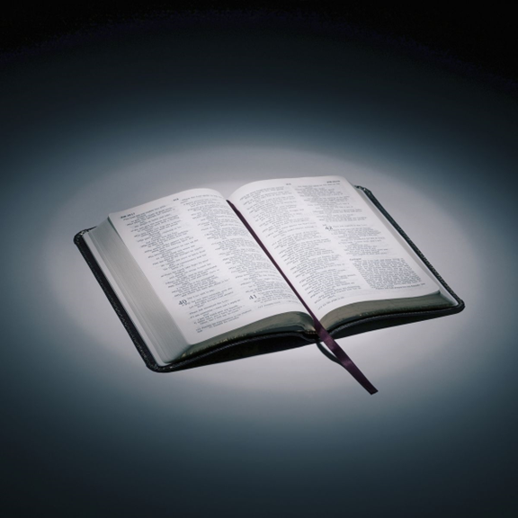
Bible reading

Slide 52
Matthew 27:45-55
⁴⁵ From noon until three in the afternoon darkness came over all the land. ⁴⁶ About three in the afternoon Jesus cried out in a loud voice, “Eli, Eli, lema sabachthani?” (which means “My God, my God, why have you forsaken me?”).

Slide 53
Matthew 27:45-55
⁴⁷ When some of those standing there heard this, they said, “He’s calling Elijah.”
⁴⁸ Immediately one of them ran and got a sponge. He filled it with wine vinegar, put it on a staff, and offered it to Jesus to drink.

Slide 54
Matthew 27:45-55
⁴⁹ The rest said, “Now leave him alone. Let’s see if Elijah comes to save him.”
⁵⁰ And when Jesus had cried out again in a loud voice, he gave up his spirit.

Slide 55
Matthew 27:45-55
⁵¹ At that moment the curtain of the temple was torn in two from top to bottom. The earth shook, the rocks split ⁵² and the tombs broke open. The bodies of many holy people who had died were raised to life.

Slide 56
Matthew 27:45-55
⁵³ They came out of the tombs after Jesus’ resurrection and went into the holy city and appeared to many people.
⁵⁴ When the centurion and those with him who were guarding Jesus saw the earthquake and all that had happened, they were terrified, and exclaimed, “Surely he was the Son of God!”

Slide 57
Matthew 27:45-55
⁵⁵ Many women were there, watching from a distance. They had followed Jesus from Galilee to care for his needs.

Slide 58
Announcements

Slide 59





Account name: Blacktown Chinese Christian Church
Account number: 4216 50263
Offering
BSB: 112 - 879
Please put in "offering" as the reference
The offering box is available at the back of the hall

Slide 60
Prayer points

Slide 61
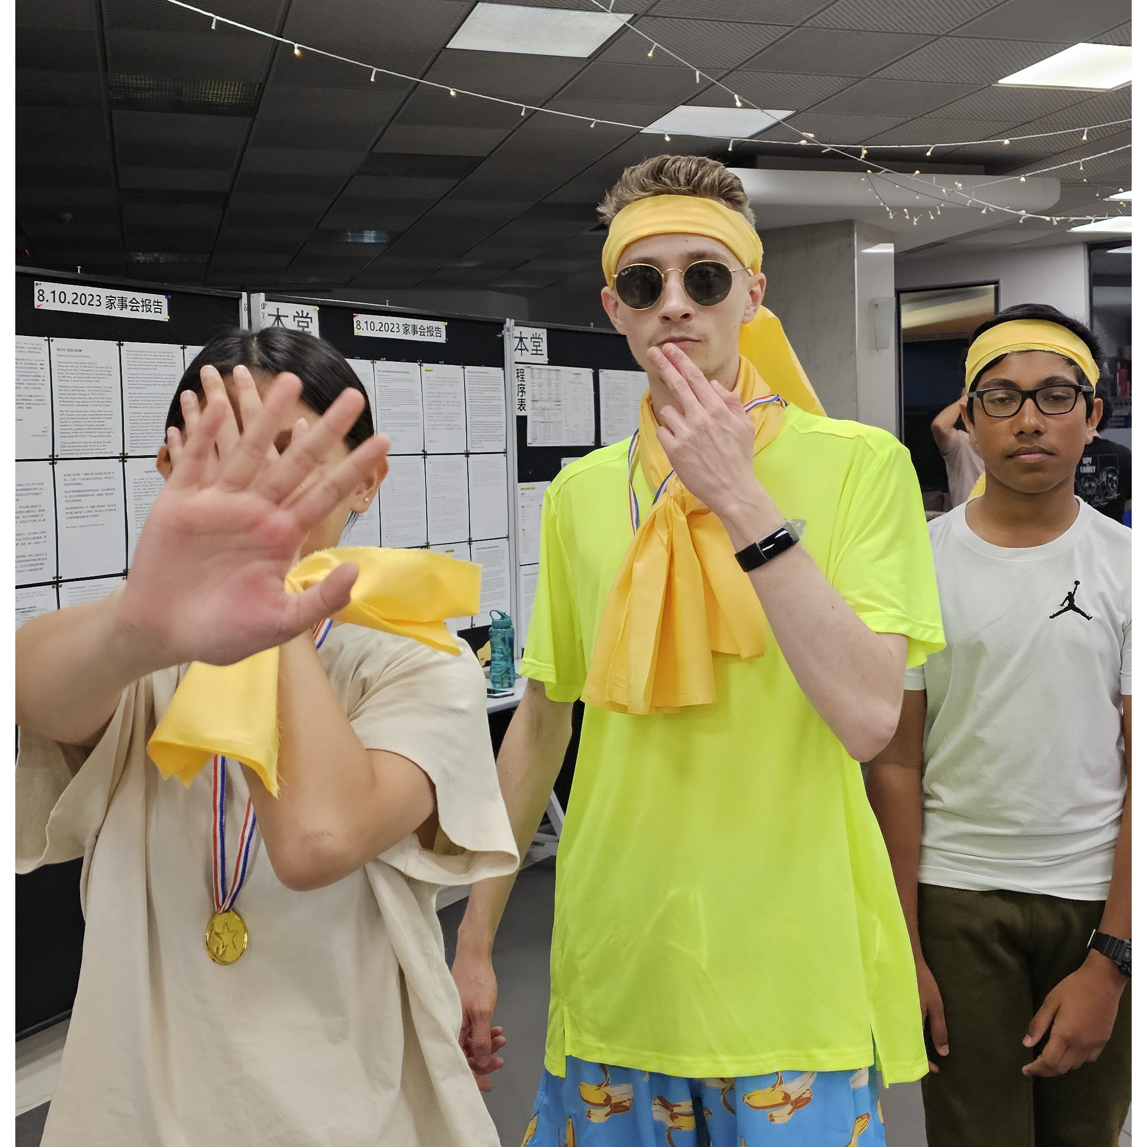
Mingle time!

